Slide 1
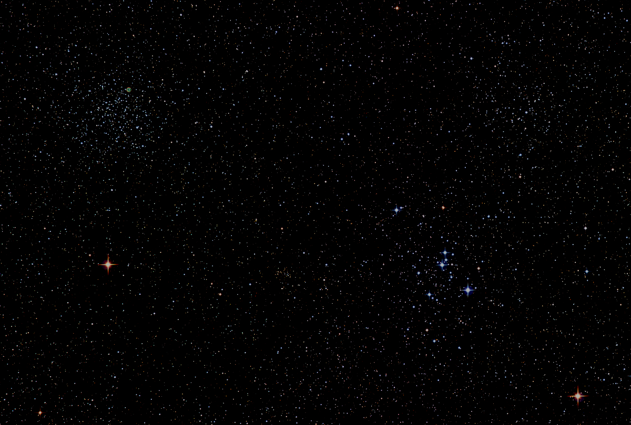
A
Brief History
of
HAL(O)

Slide 2
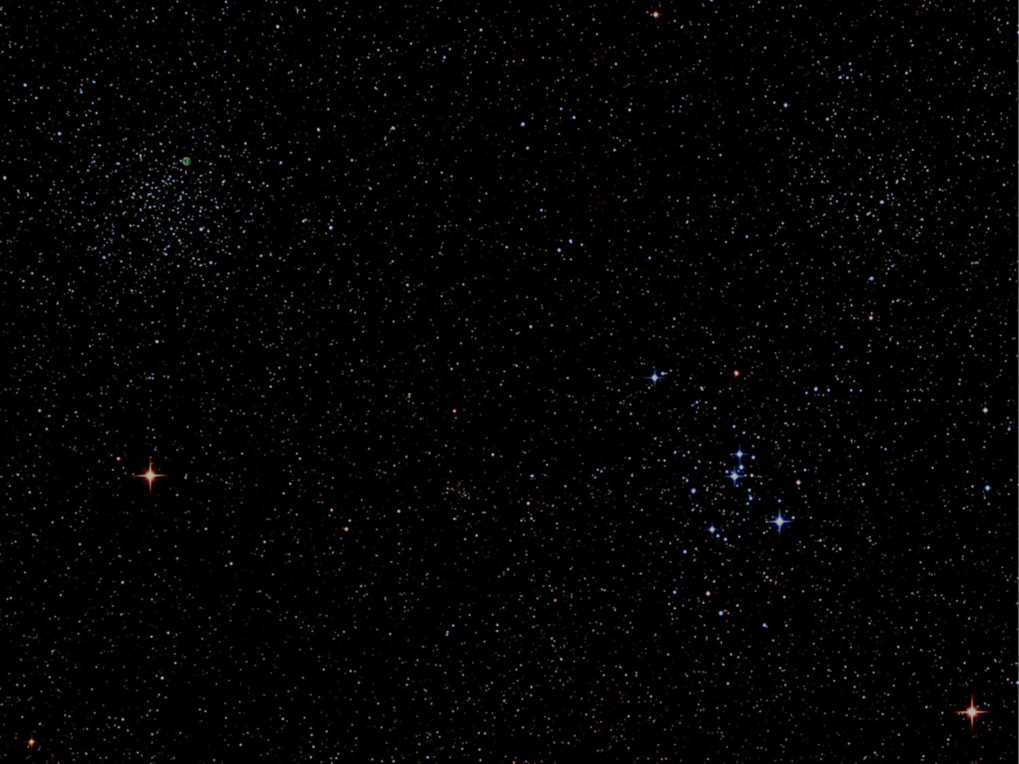
Episode MMXV
A New Observatory
A long time ago
in a galaxy within
our local group
and not Andromeda or
the Triangulum Galaxies.
It is a period of
regular observatory work.
HAL members volunteer
countless hours
to clean, construct,
and plan the finishing
work to make an
old telescope
once again functional
and the main telescope
to the HAL observatory.
Donations were made,
contractors were hired,
and the county
became a solid partner.
Troubled by rain, snow, ice,
lightning protection,
and free time
the HAL volunteers
moved on in hopes
of finishing the work
started almost
30 years ago.

Slide 3
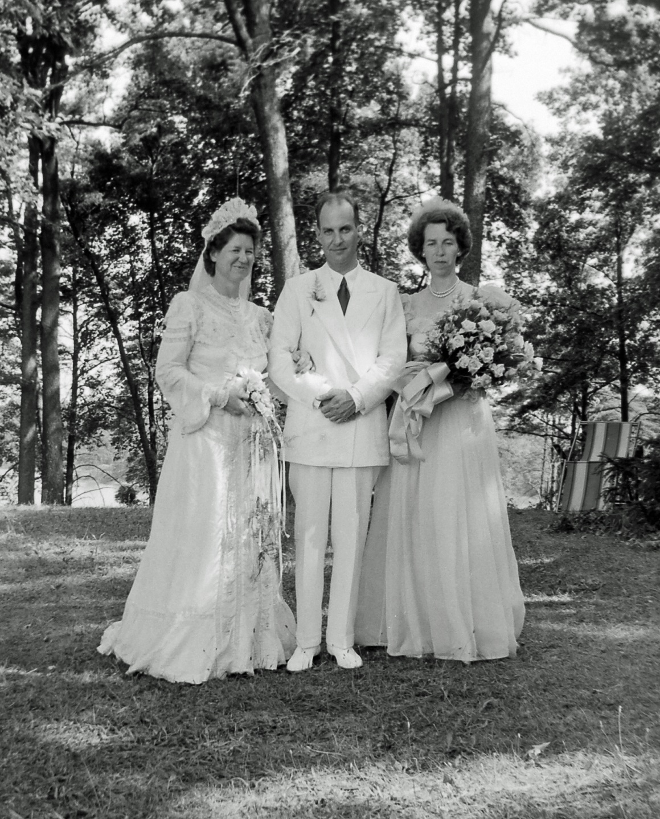
It all started with Paul Watson and a love for astronomy.

Slide 4
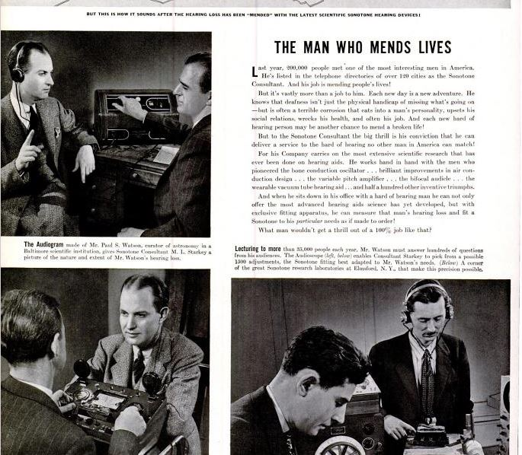

Slide 5
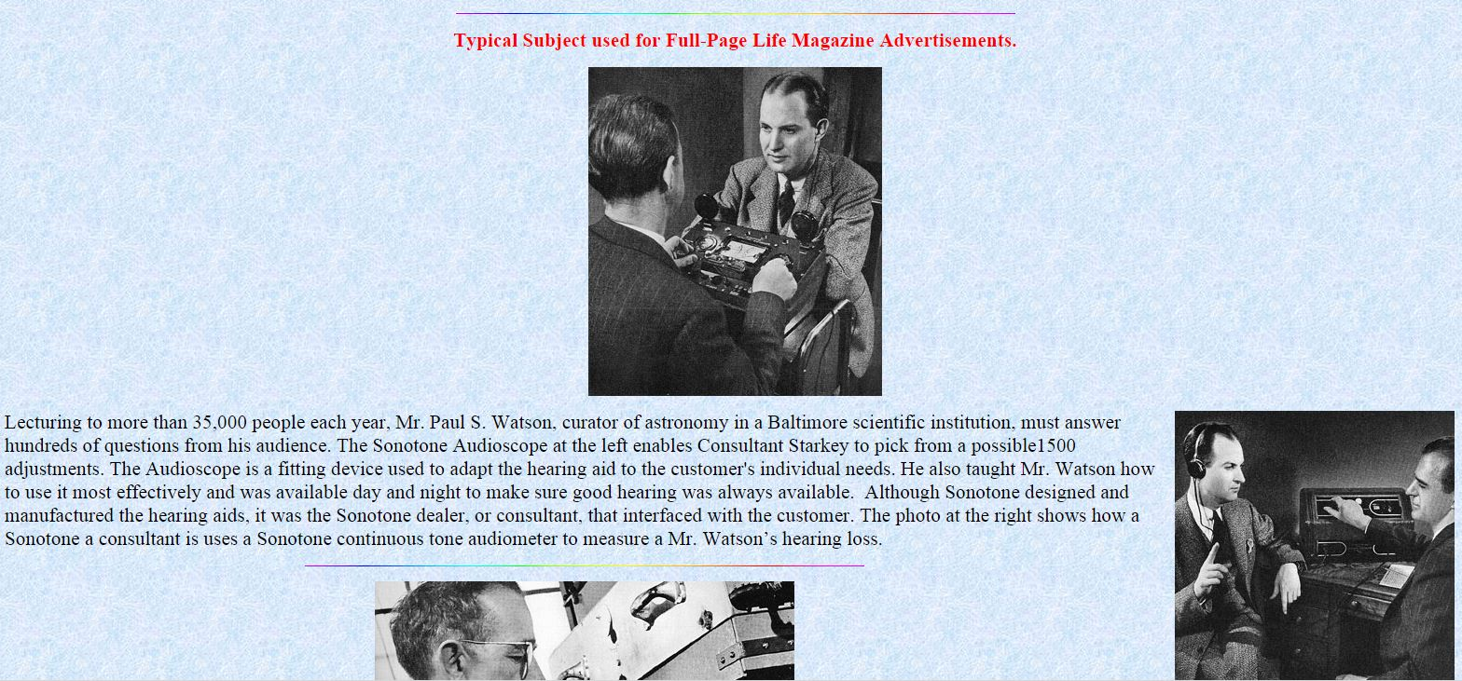

Slide 6
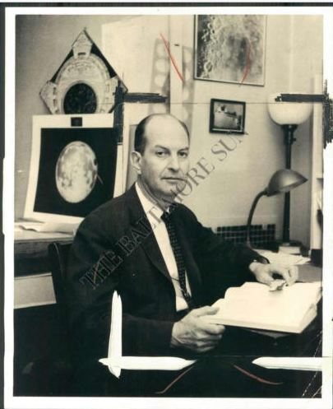

Slide 7
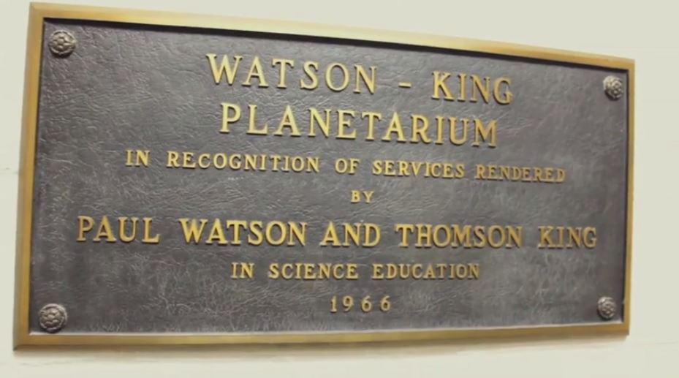
Notes:
Play Video by clicking on Hyperlinked Photo if meeting running less than 30min(730) at this time.

Slide 8
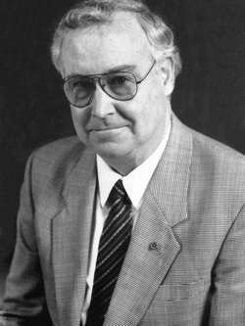
Joseph Woods
Was a toy maker
and
the man who built
the Watson Telescope
as well as the
sister telescope for
his own use.
Howard John Wood, III
1938-2014
Notes:
Howard John Wood, III no relation to Joseph Woods the once toy maker who built the Watson telescope and his personal scope, the sister scope in Northwood. Howard John Wood grew up and lived near Joseph Woods. He would visit and often view through the other telescope. He worked for NASA Goddard and offered to help the new home owners fix the telescope before passing away in 2014 . We have contacted the new owners and hope the press about our telescope will help build a friendship with them and lead to restoring the other telescope.
The telescope was constructed by Joseph Woods entirely of custom-machined pieces. As a professional instrument in its day, its optical and mechanical accuracy rivals the best telescopes currently being made. To bring this telescope completely up to modern standards, the original mechanical "clock drive" was replaced with an electronic tracking mechanism. However, the original clock drive was an amazing device for its day. For more information on that device click here. This will initially be used as a "Push-To" scope.
Optical accuracy also rivals the best current telescopes. Optical testing in 2005 revealed the 12-inch primary mirror to be accurate to within 1/12th the width of a wave of light.
http://quest.nasa.gov/dso/team/wood.html
http://www.beallfuneral.com/memsol.cgi?user_id=1445553

Slide 9
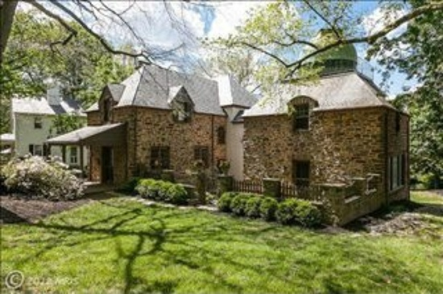
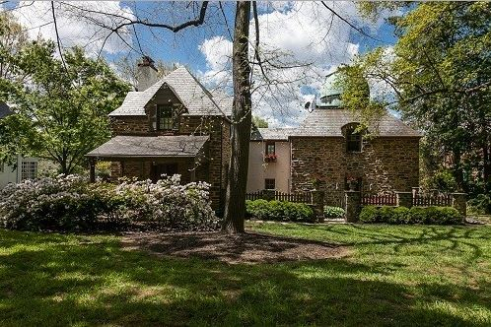
Notes:
Northwood observatory house with the sister scope to the Watson Telescope. Built on Westview Rd in 1937. BAS ands MD Academy of Sciences met here often.
http://static.squarespace.com/static/51301fa4e4b095f36e7103f4/t/522788eee4b0ba1abb1054d5/1378322670851/ONA%20Network%20-%20Fall%202013.pdf

Slide 10
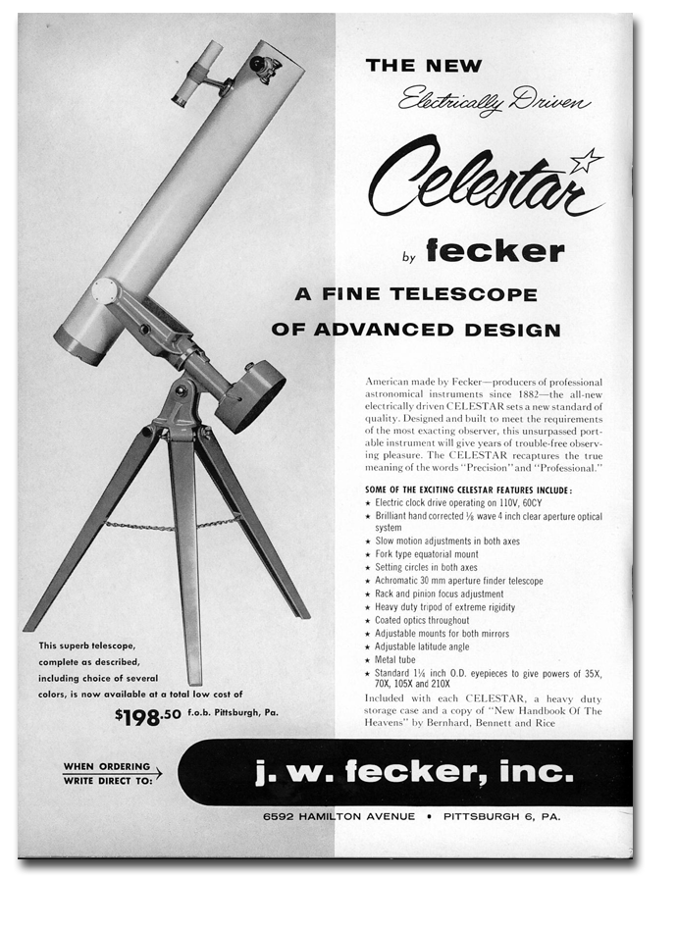
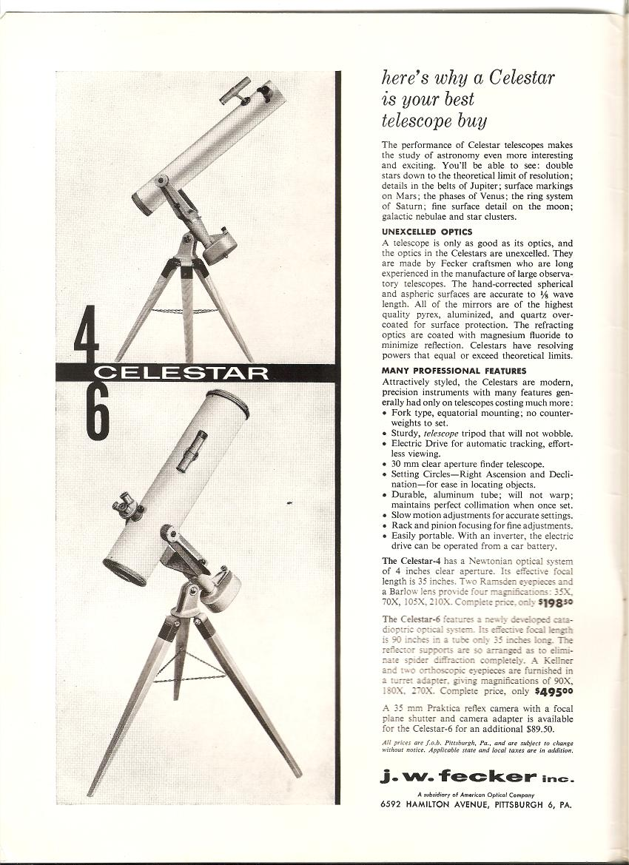
Notes:
Fecker was based near Pittsburgh but is out of business today. One of many companies:
The J.W. Fecker Company, Pittsburgh, PA, no longer exists as such; it was
just one phase in a corporate lineage that stretches back to John Brashear:
Interval Corporate Name
1881 - 1920s John Brashear Co.
1920s - 1960s J.W. Fecker Company
1960s - 1974 A division of the Kollmorgen Company?
1974 - 1997 Contraves Goerz (name was later shortend to just Contraves)
1997 - 1999? Contraves Brashear Systems (a transitional name)
1999? - Brashear Systems
(Note the ressurrection here of the venerable Brashear name!)
More information about the company's current incarnation is available at
http://www.contraves-brashear.com .
http://www.butlerartfest.com/holcomb-observatory/history/jw-fecker/

Slide 11
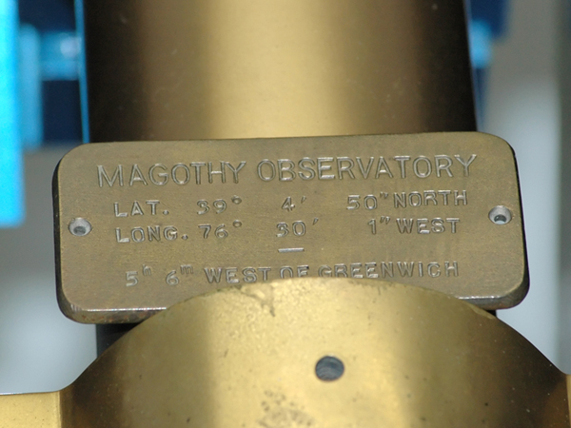

Slide 12
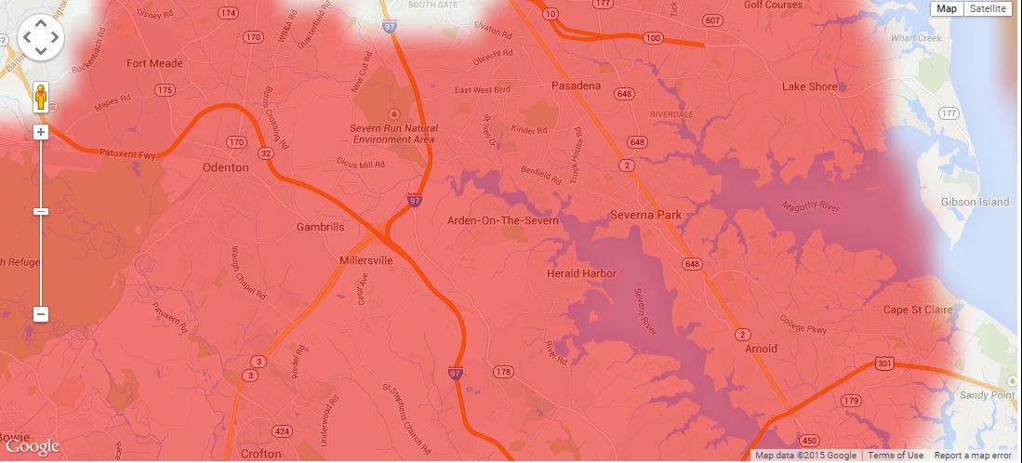
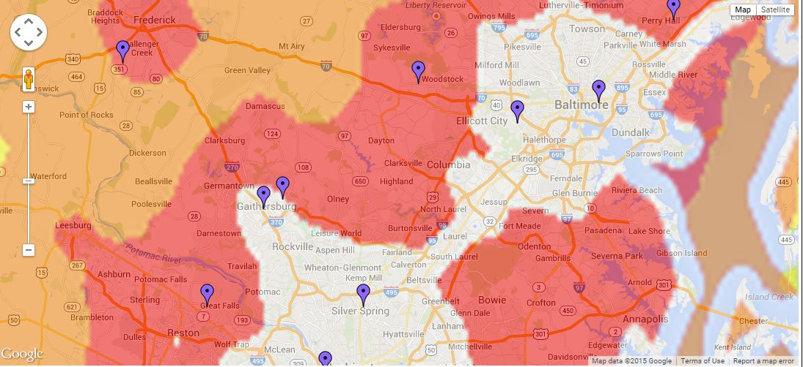
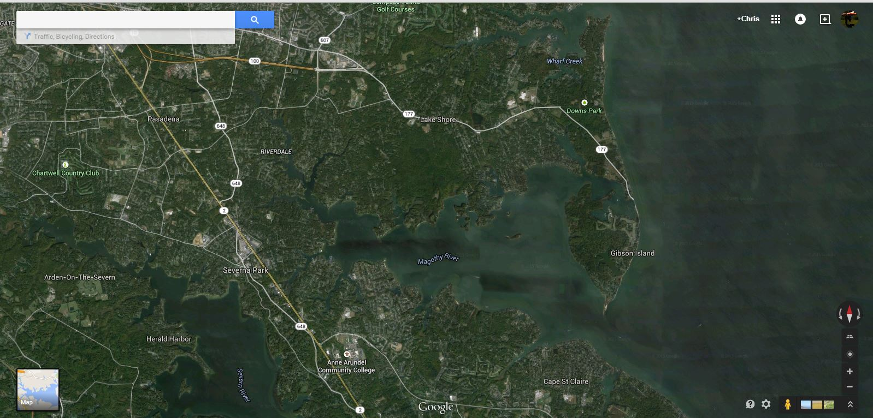

Slide 13
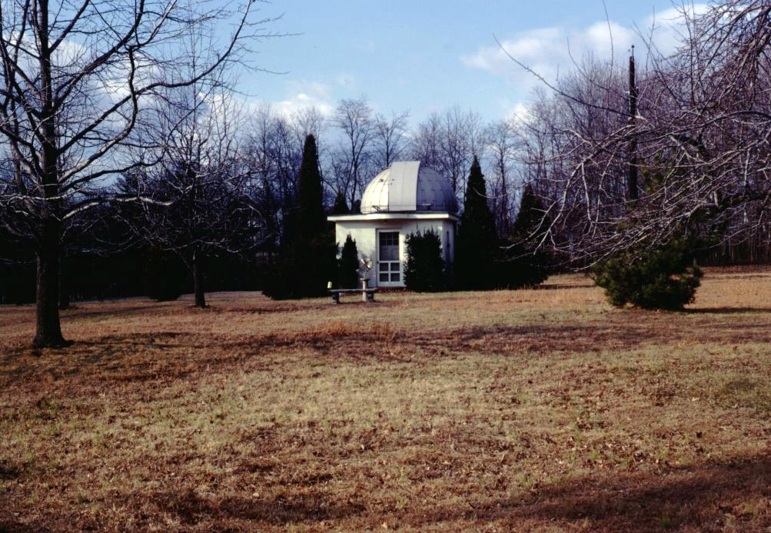
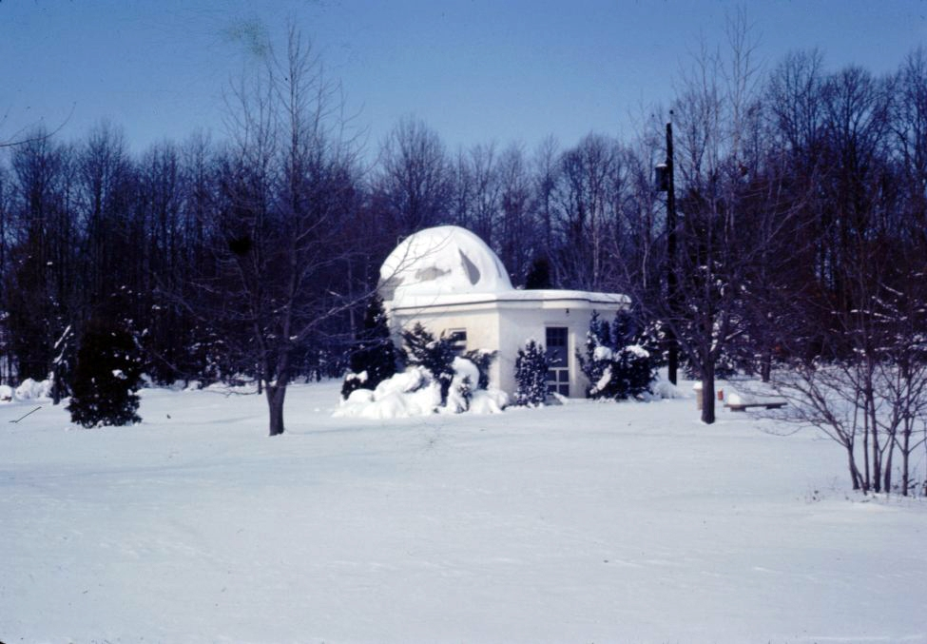
Notes:
Magothy River Observatory Site
Even the Watson Observatory had snow covering its dome.

Slide 14
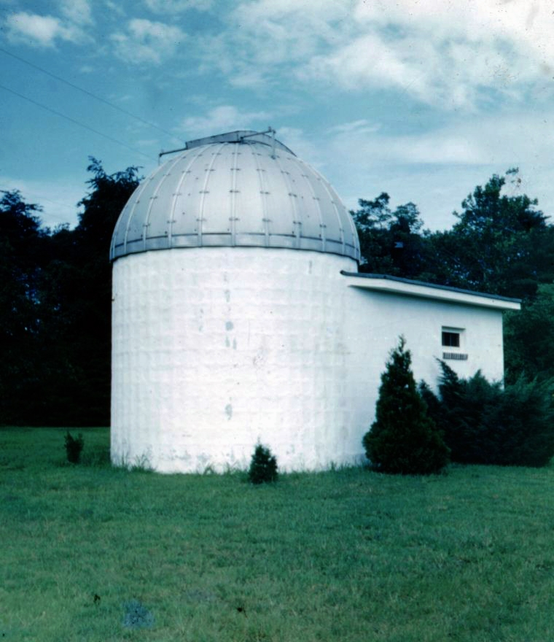
Notes:
Magothy River Observatory

Slide 15
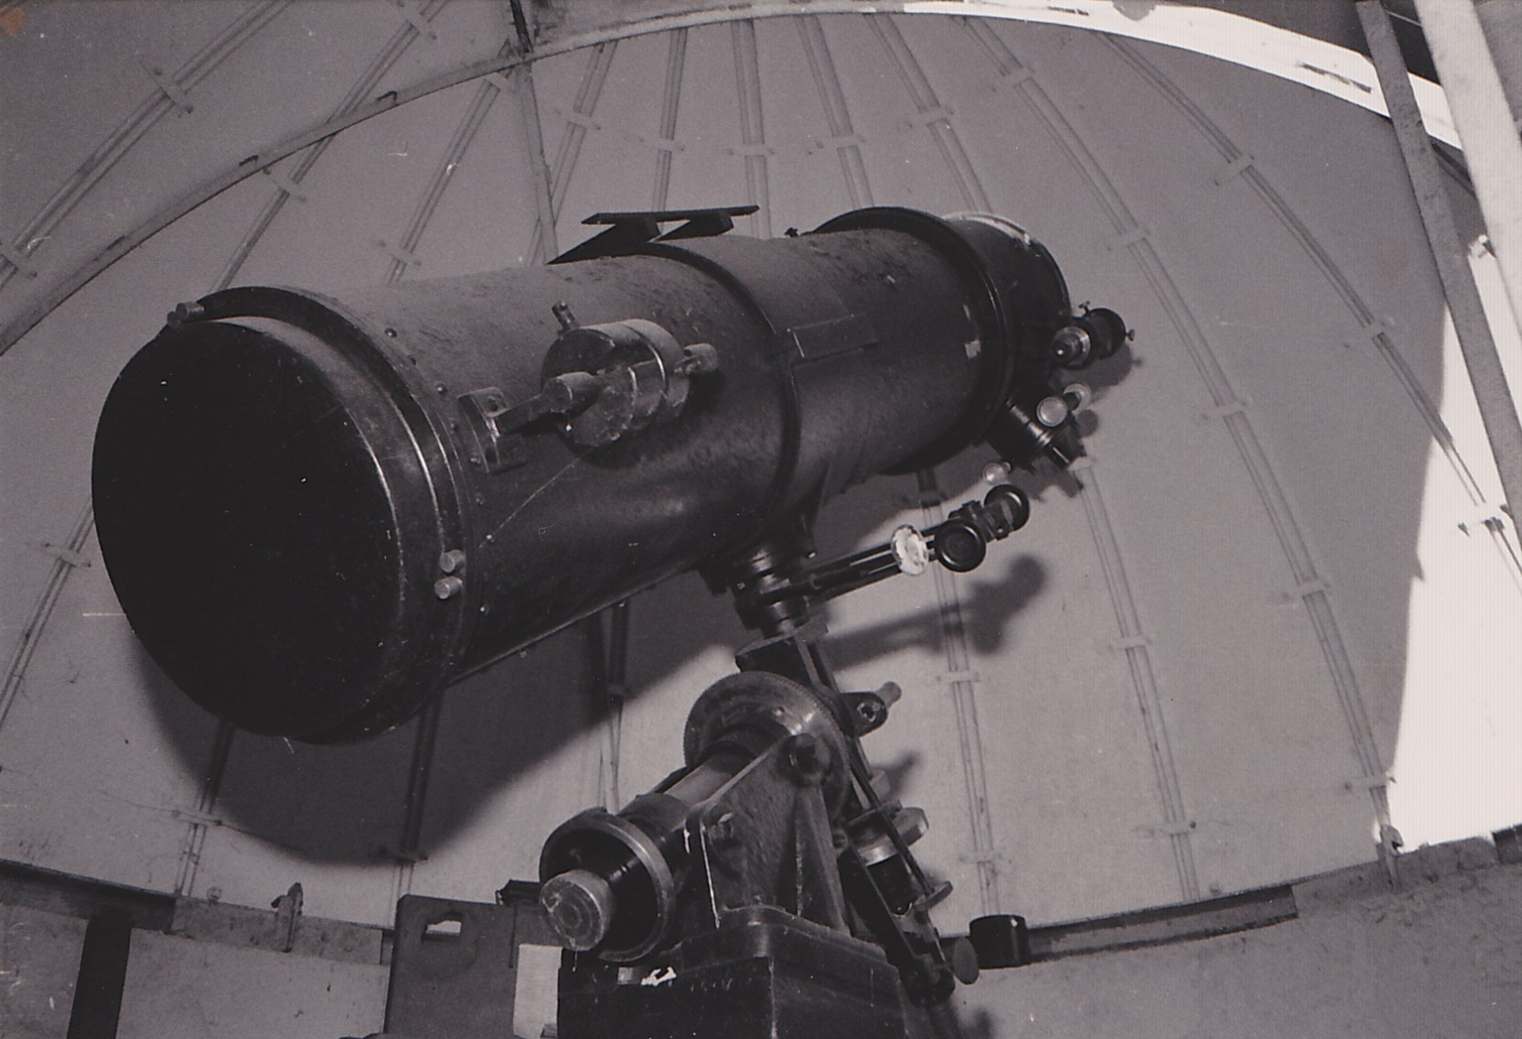
Notes:
Inside Magothy River Observatory
The Watson telescope is a 12-inch, F6.0 Newtonian on a German equatorial mount. Although the optical and mechanical configuration of the telescope is not unusual, its unique construction makes it one of a kind. Its mechanical and optical components were machined to the most precise level of accuracy. The amazing craftsmanship and attention to detail surpasses the capabilities of modern mass produced telecopes

Slide 16
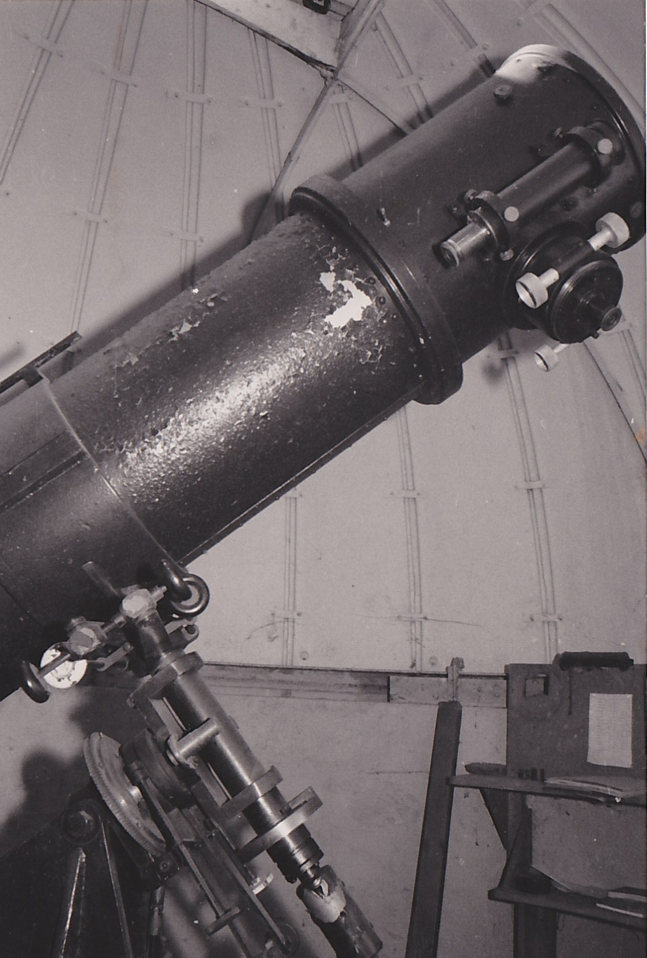
Notes:
The Watson telescope is a 12-inch, F6.0 Newtonian on a German equatorial mount. Although the optical and mechanical configuration of the telescope is not unusual, its unique construction makes it one of a kind. Its mechanical and optical components were machined to the most precise level of accuracy. The amazing craftsmanship and attention to detail surpasses the capabilities of modern mass produced telecopes

Slide 17
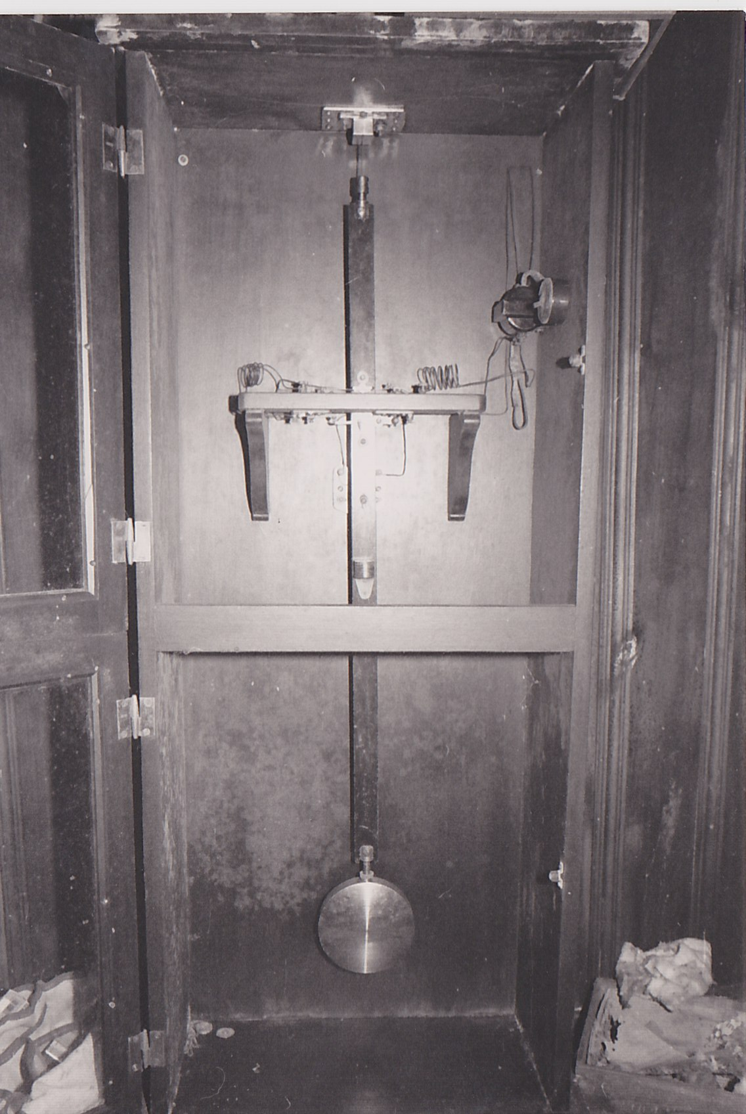
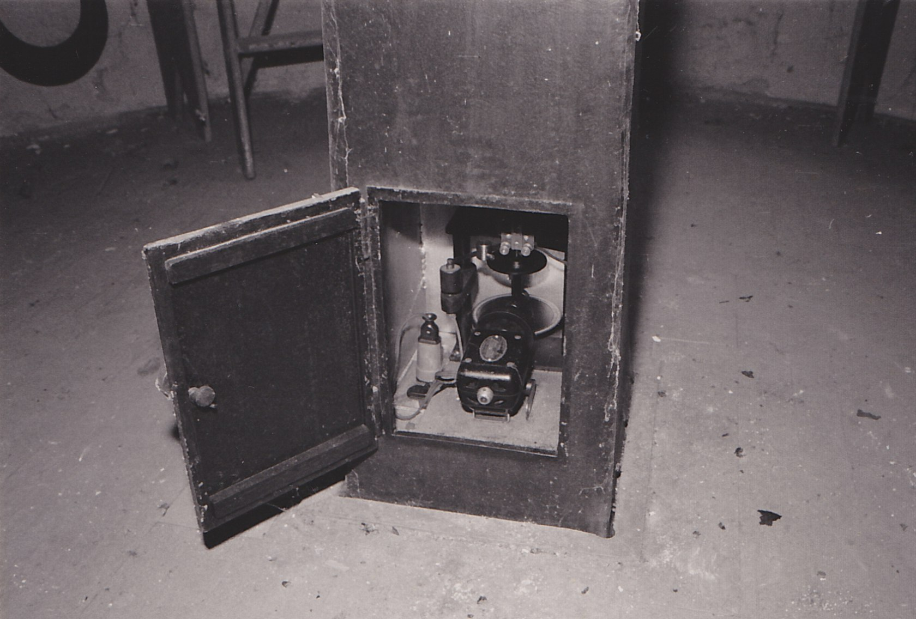
Notes:
As a professional instrument in its day, the Watson telescope's mechanical accuracy rivals the best telescopes currently being made. It employed a
mechanism to track astronomical targets in right ascension that was driven by a small motor regulated by a series of falling weights and a swinging
pendulum, much like a grandfather clock. When originally decommissioned in 1988, the tracking was found to lose only 1 second per month of
continual tracking.
It was this kind of original clock-regulated tracking mechanism that gave rise to the name of right ascension motors still used on telescopes to this
day. Although now regulated with electronic circuitry, they are still called " clock drives". This part of the original telescope will not be reused.
HAL plans to retrofit the Watson scope with a modern computer controlled tracking mechanism. This retrofit has now been completed compliments
of Company Seven.

Slide 18
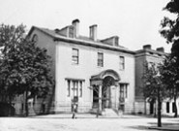
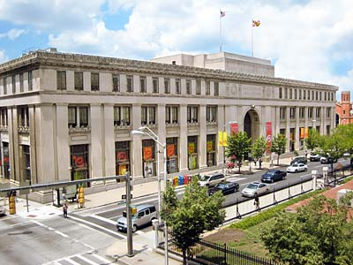
Maryland Academy of Sciences Original Location
Maryland Academy of Sciences new location after WWII at Encoh Pratt Library
Notes:
Maryland Academy of Sciences original building and short term location after WWII at Enoch Pratt Library.
In 1988, several prominent members of the Baltimore Astronomical Society (BAS) formed an organization called the Friends of the Baltimore Astronomical Society (FOBAS). It was formed in order to receive, restore, and create a home for a beautiful 12" Newtonian telescope donated from the Estate of Paul S. Watson. FOBAS began the telescope's restoration work and raised money to establish an observatory for it. Then, for to a variety of issues, FOBAS and the restoration project stalled until 1999. At that time, FOBAS and the BAS conducted a vote and decided to discontinue FOBAS as an organization and gift the Watson telescope and cash assets ($2,144) to help start a new club. Founding members - Dana Gelabert-Boltersdorf, Michael Hall, ZoAnn Lapinsky Macon, Mary Kay Sigaty, and Malcolm Willette formed the Howard Astronomical League as non-profit corporation on December 5, 1999.

Slide 19
Retrieving the Watson Telescope at the Magothy River location…

Slide 20
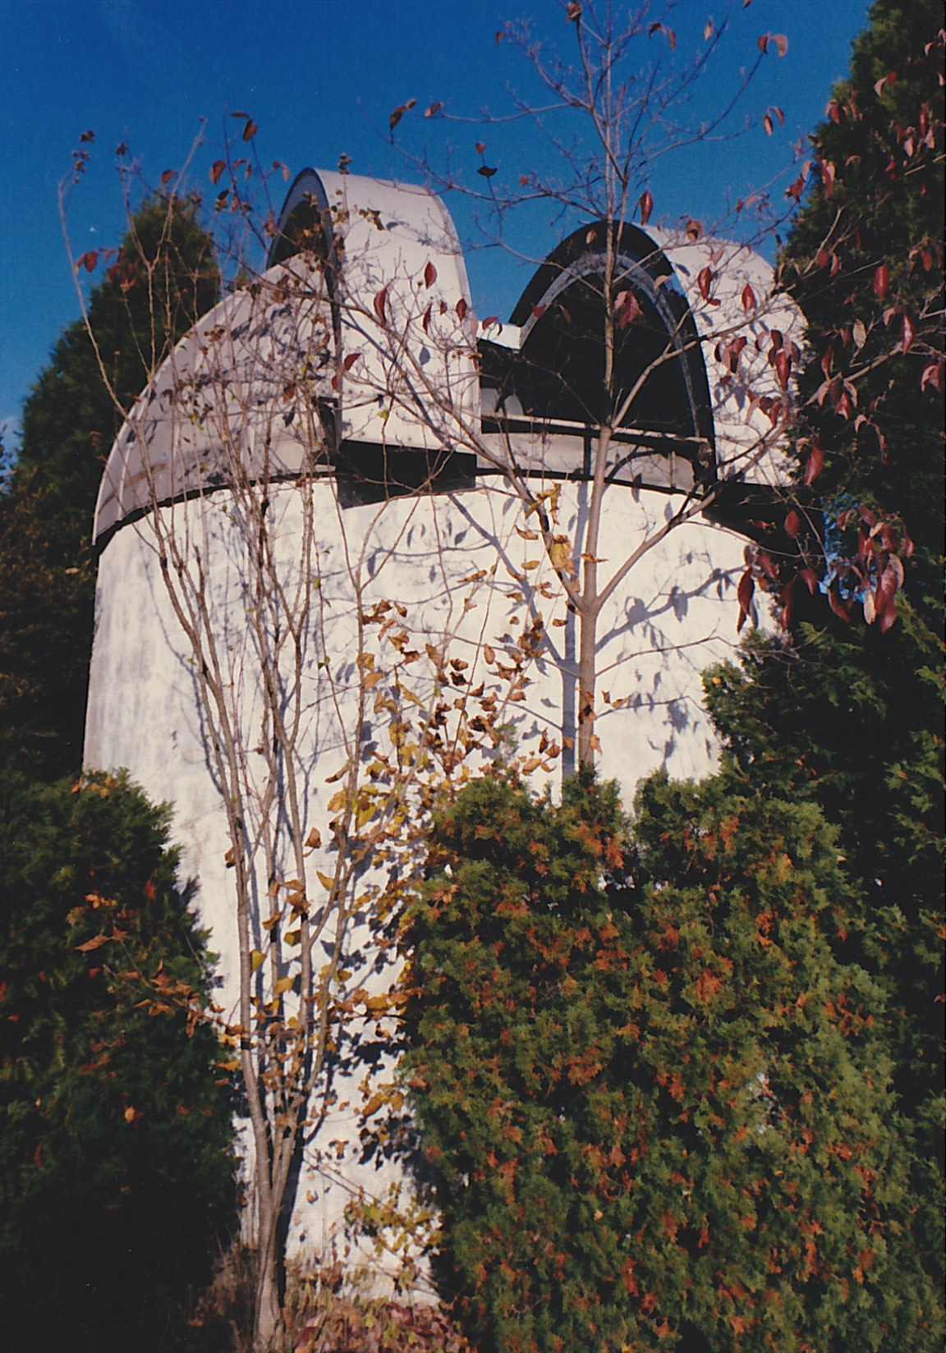
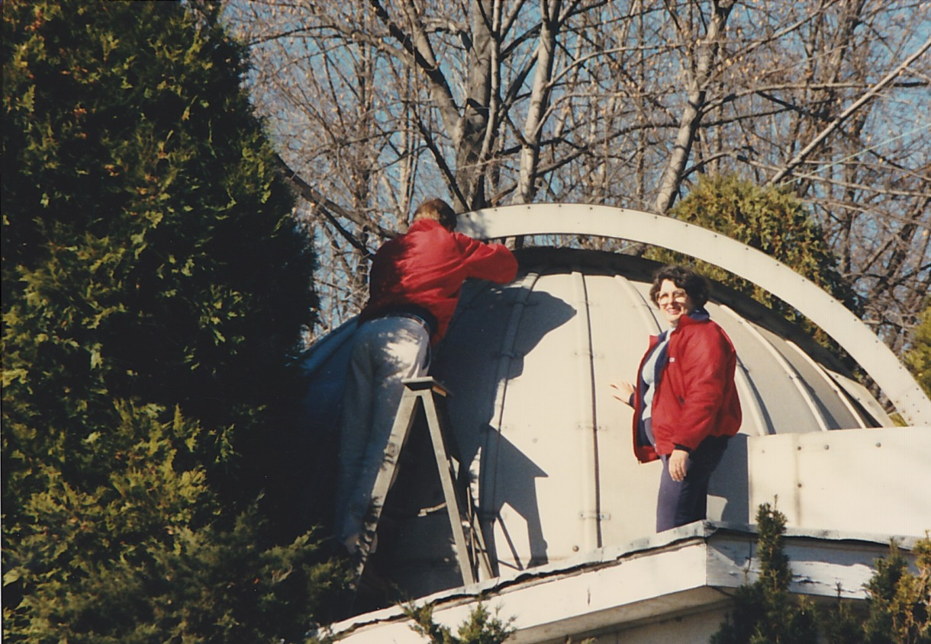

Slide 21
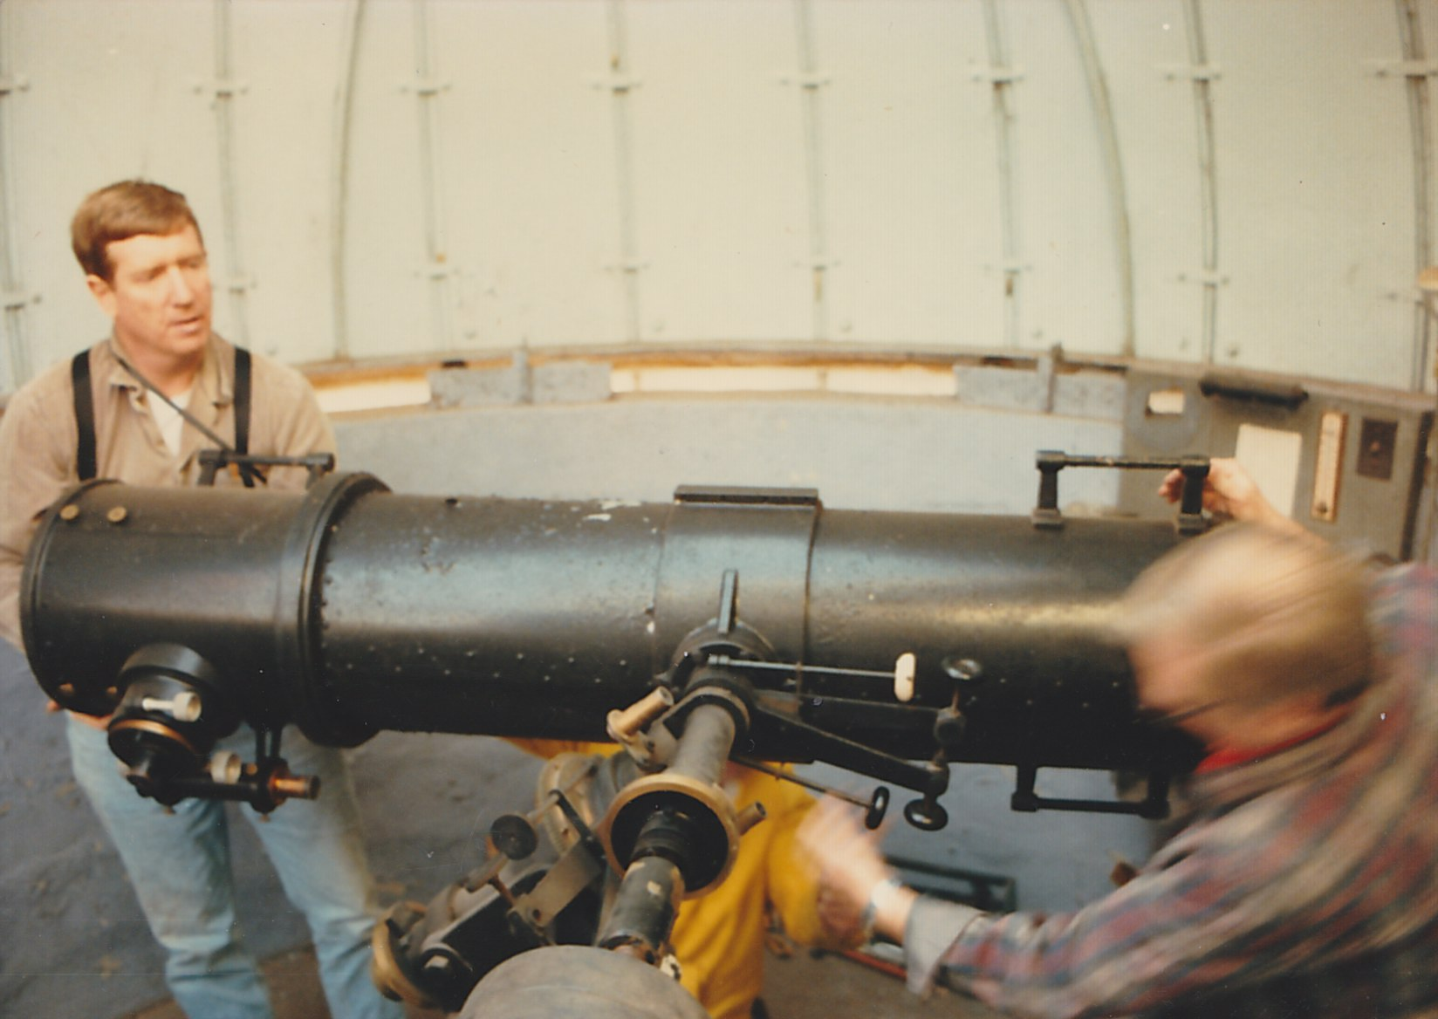

Slide 22
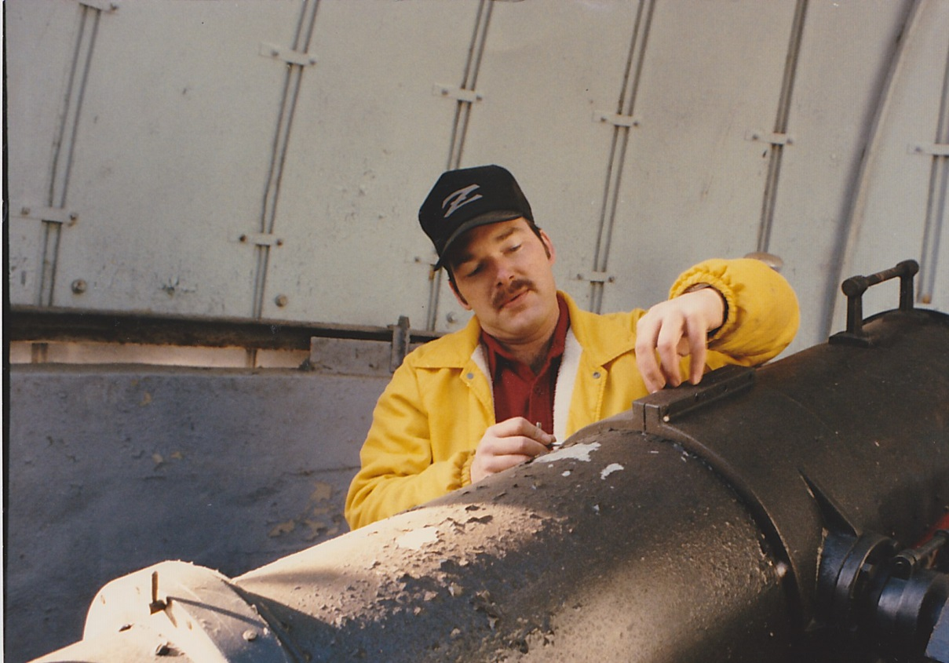
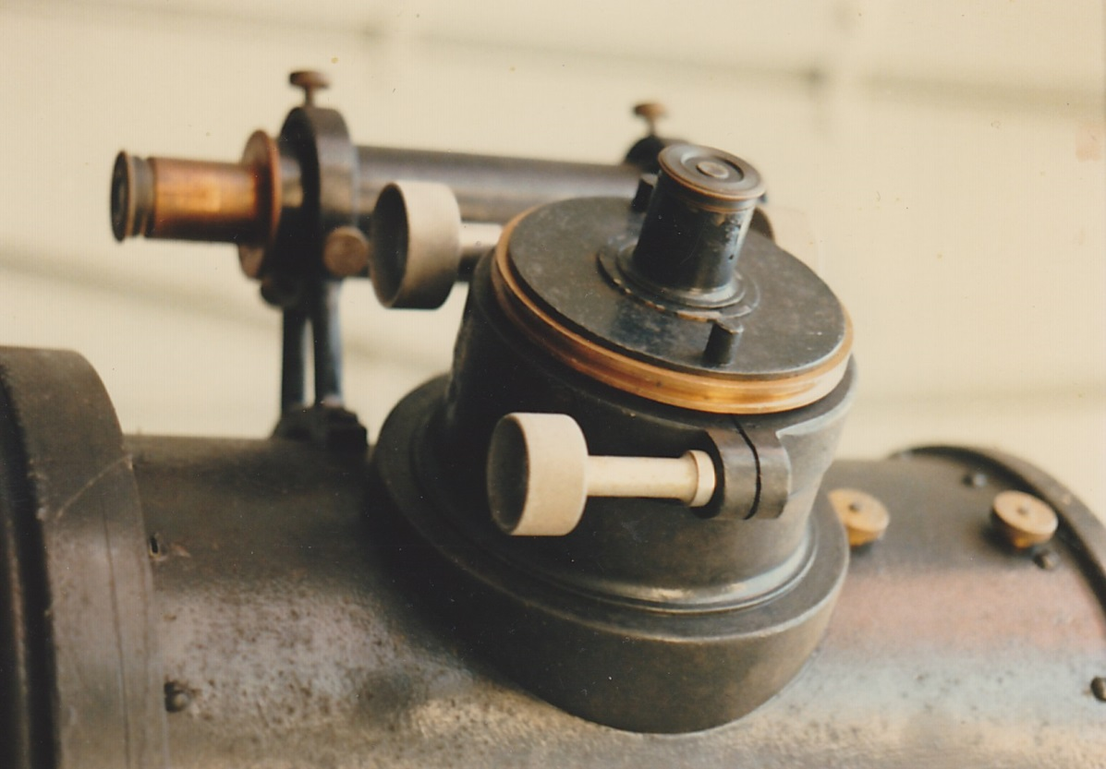

Slide 23
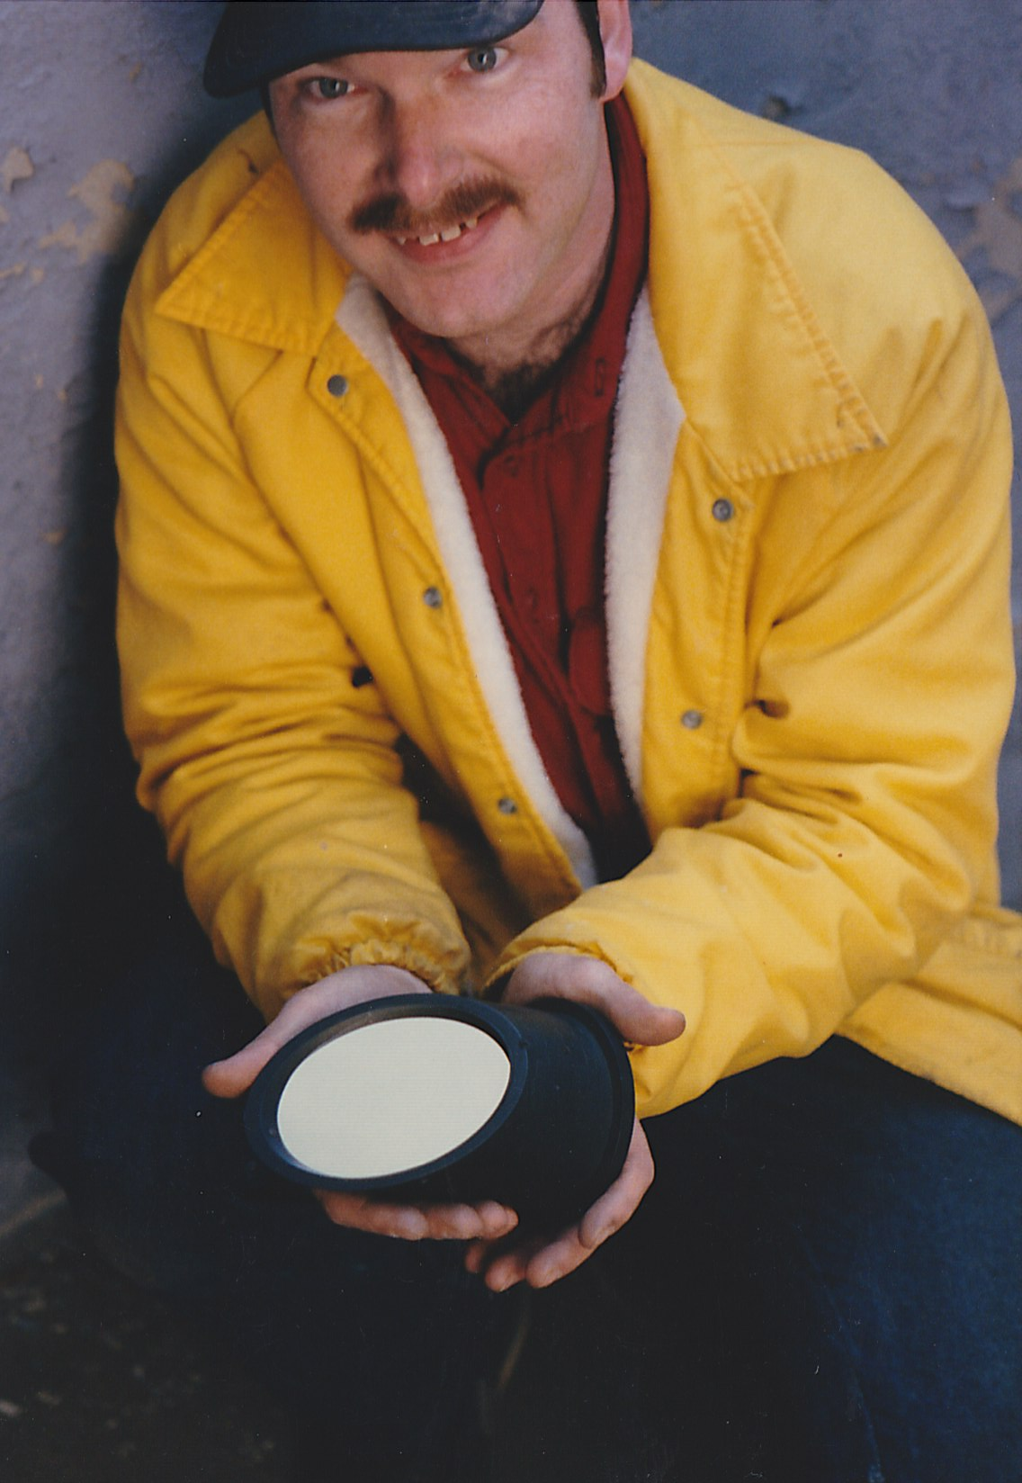
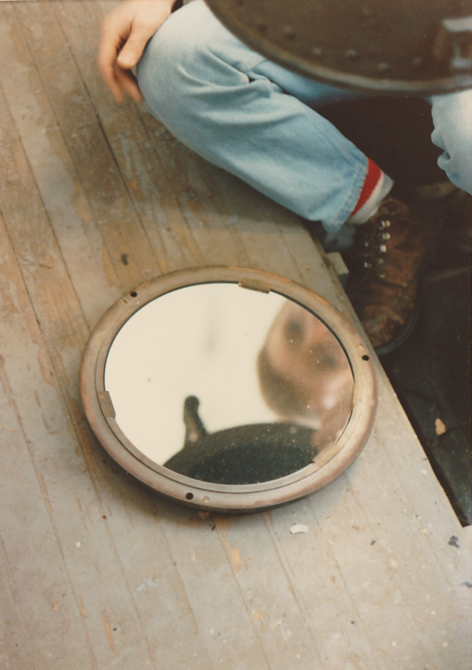

Slide 24
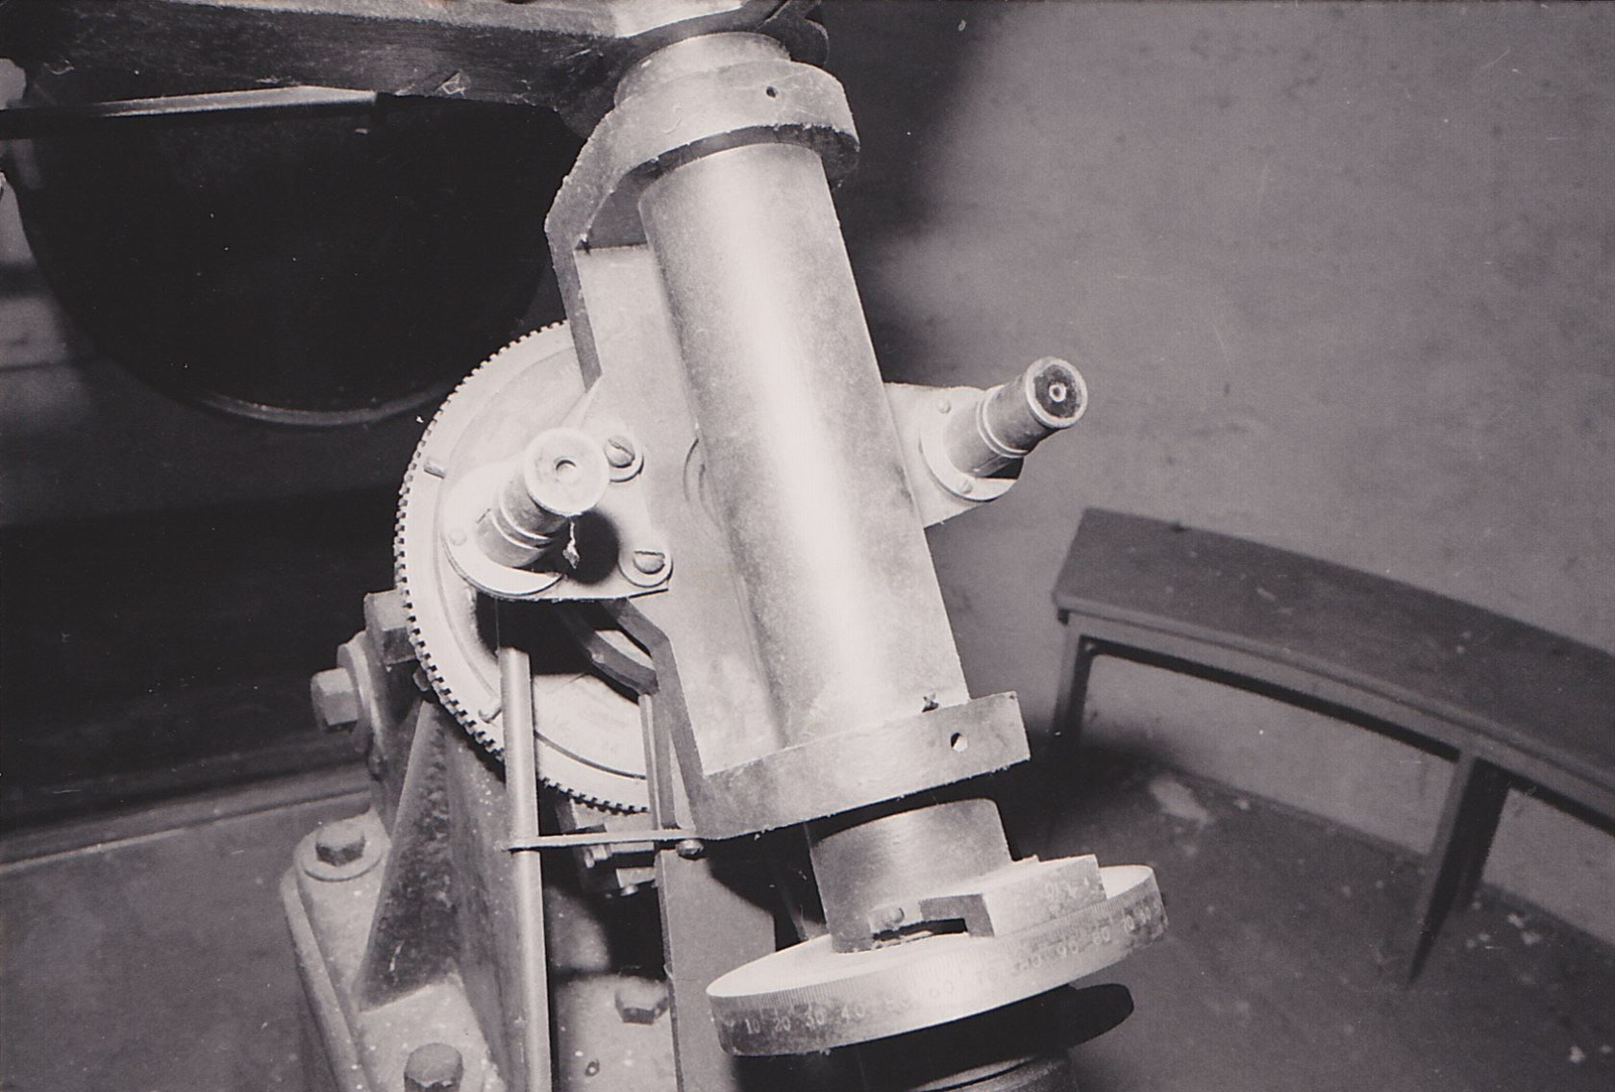

Slide 25
An initial setup
back in
2005…

Slide 26
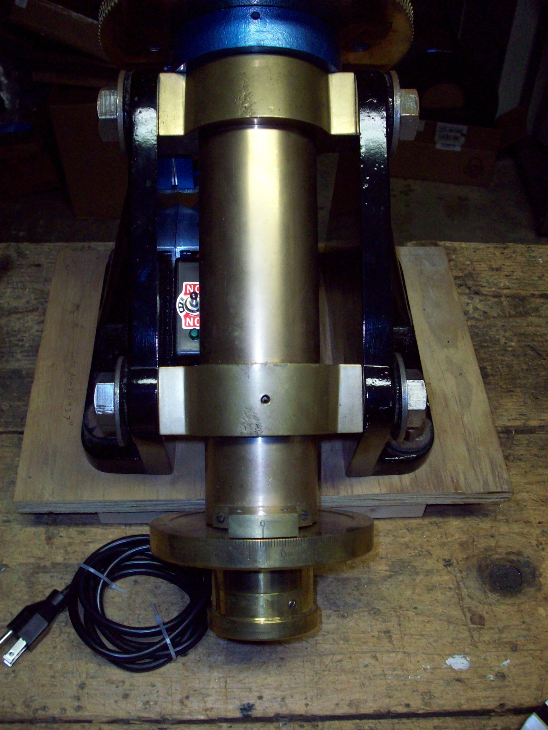
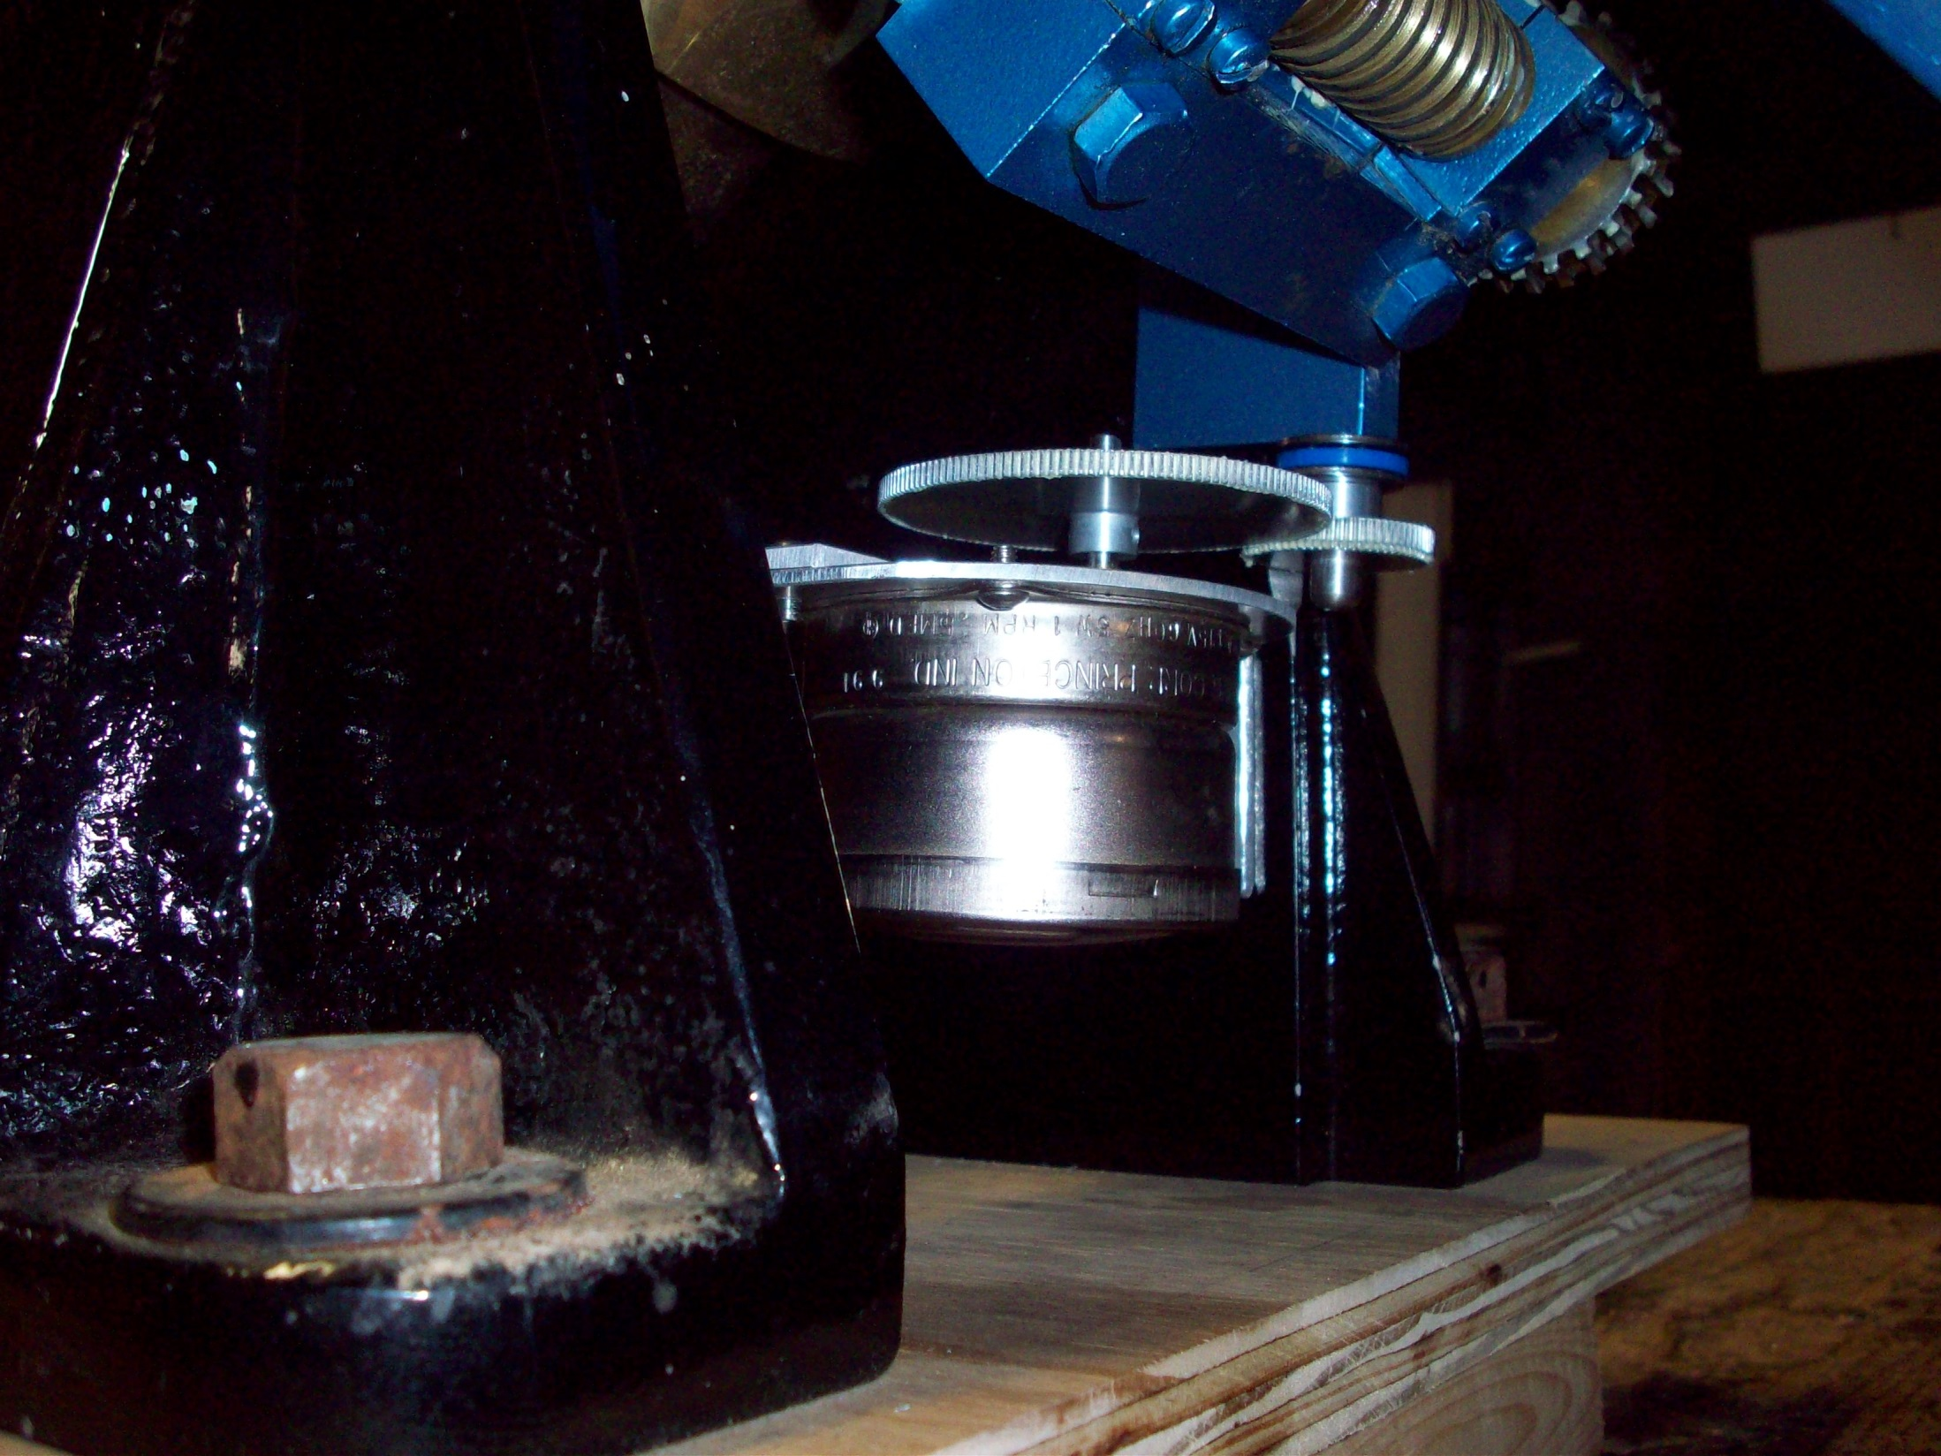

Slide 27
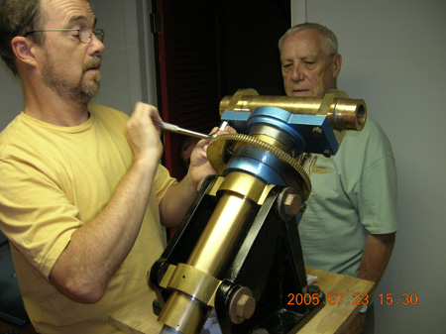
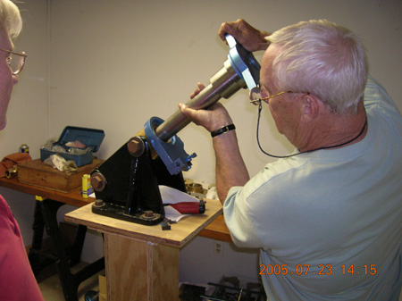

Slide 28
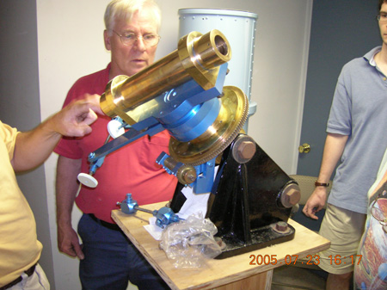
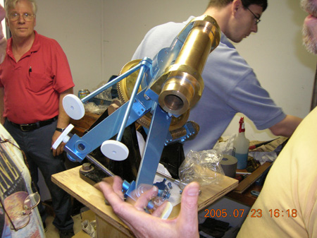

Slide 29
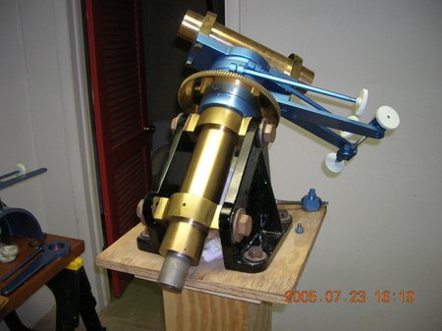

Slide 30
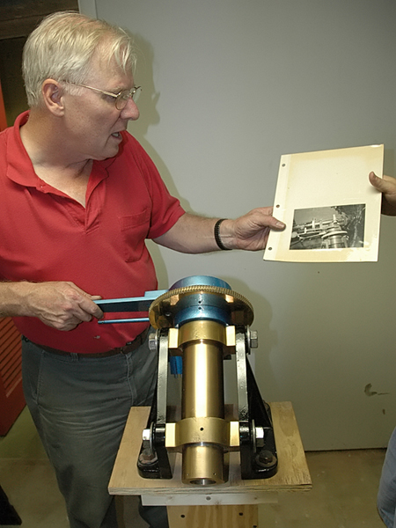
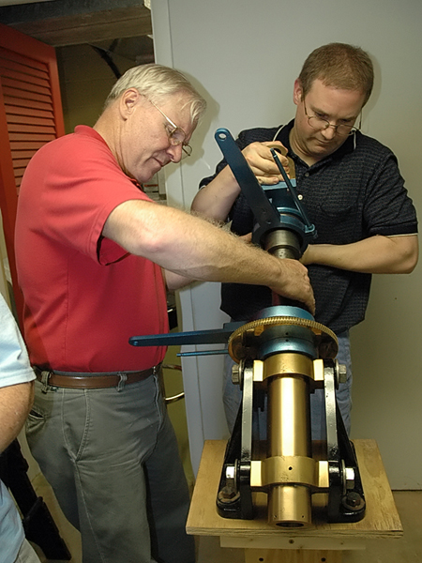
Notes:
Malcolm and Marc working on the EQ Mount

Slide 31
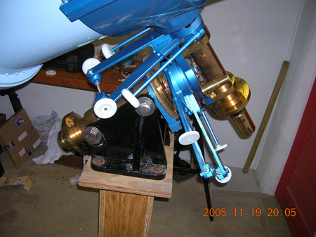
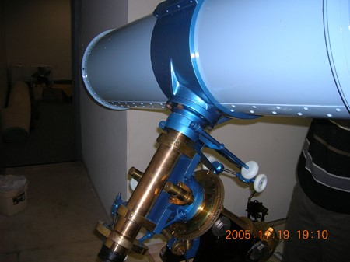

Slide 32
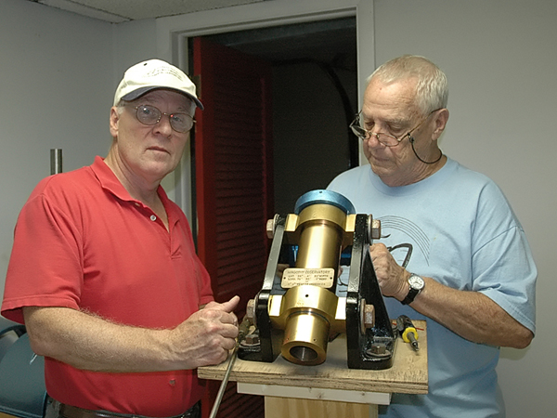
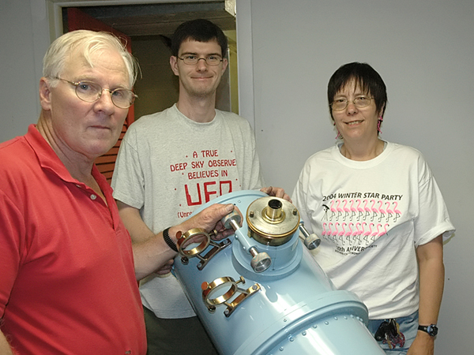

Slide 33
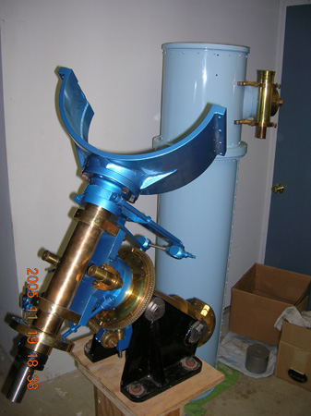
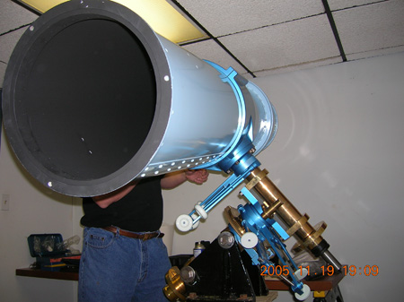

Slide 34
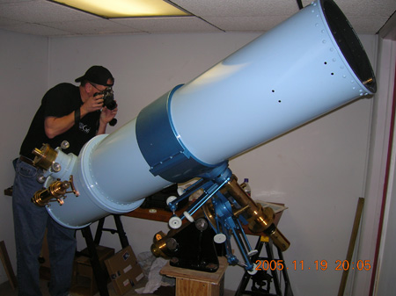
Notes:
Come on Guys it is facing the ground?

Slide 35
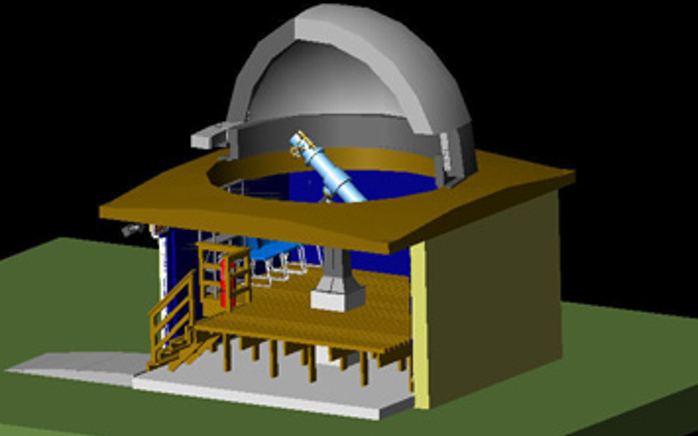

Slide 36




Slide 37
With a plan underway,
the dome is purchased
and move around
awaiting a good clean up and its final destination at Alpha Ridge.

Slide 38



Slide 39



Slide 40



Slide 41
At
Joel’s House…

Slide 42


Notes:
Joel telling us a story of how big of a fish he caught with just dental floss.

Slide 43



Slide 44


Slide 45



Slide 46


Slide 47
Meanwhile at Alpha Ridge Park…

Slide 48



Slide 49



Slide 50


Slide 51



Slide 52



Slide 53



Slide 54



Slide 55
Back
at
Joel’s House…

Slide 56



Slide 57



Slide 58



Slide 59


Slide 60



Slide 61


Slide 62



Slide 63


Slide 64

Notes:
The paint job was causing trouble fitting pieces together correctly. We had to remove paint in areas for proper fit.

Slide 65
More work…

Slide 66

Notes:
Finish work on dome and shutter before removing scaffolding and setting up the telescope.

Slide 67


Notes:
Lots of planning on how to setup the observatory

Slide 68


Notes:
New 2” focuser mount fabricated by GAK Welding to replace the original part to hold modern equipment and assist in back and in focus.

Slide 69



Slide 70

Grand Opening – Ribbon Cutting July 2015

Slide 71


